Slide 1


Slide 2

Tribhuvan University
Institute Of Science and Technology
Birendra Multiple Campus
A PROJECT REPORT
ON
“TREKKING EQUIPMENT RENTAL”
Submitted to
Department of Computer Science and Information Technology
Birendra Multiple Campus
In partial fulfillment of the requirements for the Bachelor of Science in Computer Science and Information Technology
Submitted by
Suyog Mani Kandel (68) (Registration no.: 5-2-19-167-2019) (24913/076)
Prakriti Adhikari (20) (Registration no.: 5-2-19-114-2019) (24878/076)
Sudip Timilsina (32) (Registration no.: 5-2-19-163-2019) (24909/076)
MARCH, 2024

Slide 3
introduction
Trekking has been gaining popularity in recent years. Many people are drawn to trekking as a way to explore nature, challenge themselves physically and mentally, and disconnect from the stresses of modern life. Trekking allows individuals to immerse themselves in the natural beauty of various landscapes, from mountain trails to dense forests, coastal paths, and more. Trekking equipment can vary in price depending on their quality, brand, and the specific needs of the trekking activity.
Trekking Equipment Rental is a dynamic website where costumer can rent any trekking equipment by creating an account. This website provides high-quality, reliable and affordable equipment’s. Bringing affordable and trusted equipment that consumer can rent instantly. This site also provides several dynamic features.

Slide 4
Problem statement
Buying trekking equipment cannot be practical and cost effective at the same time, especially for those who don’t trek frequently or if you’re planning a one-time trek to a specific destination.
Ill-fitting equipment such as hiking boots and backpacks can lead to discomfort and injury during your trek.
Trekking equipment can vary depending on the specific needs of the trekking activity.
Change of preference or taste.

Slide 5
objectives
Renting allows you to access high-quality products without the upfront costs of purchasing expensive equipment.
Ensure that the equipment rented are of desired size and fits properly.
To make easy adaptation according to the requirement.
To make easy alteration according to the change of preference.

Slide 6
Scope and limitation
Nepalese people are so sensitive in terms of price and service quality at the same time. So, this website is developed for providing quality services in affordable price as much as possible reviewing the Nepalese market. This website helps to promote tourism in Nepal as it makes trekking and hiking affordable by decreasing the budget for buying individual equipment’s for their activity.
Limitations: -
Not all people use them for their activity.
Unable to use without mobile/computer and internet knowledge.

Slide 7
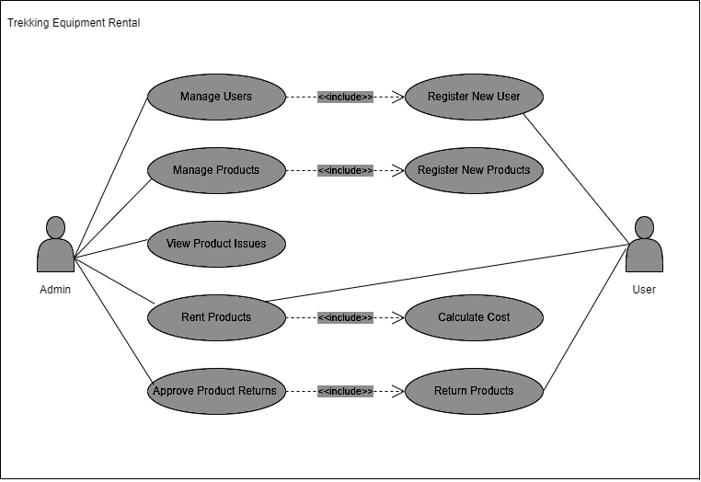
Use case diagram

Slide 8
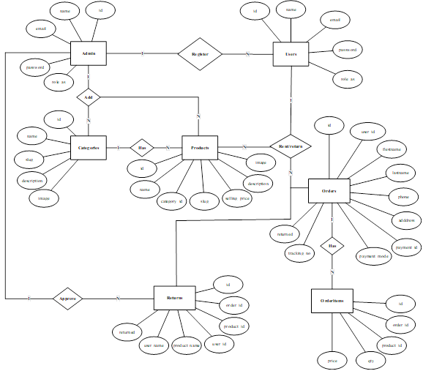
Data modeling (er-diagram)

Slide 9
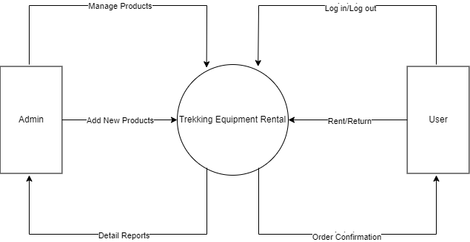
Process modeling (level-0 dfd)

Slide 10
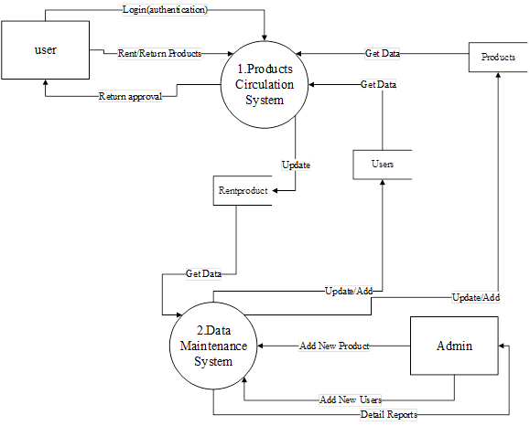
Process Modeling (level-1 dfd)

Slide 11
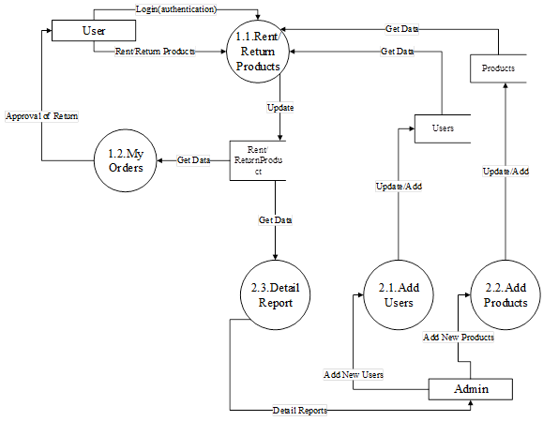
Process modeling (level-2 dfd)

Slide 12
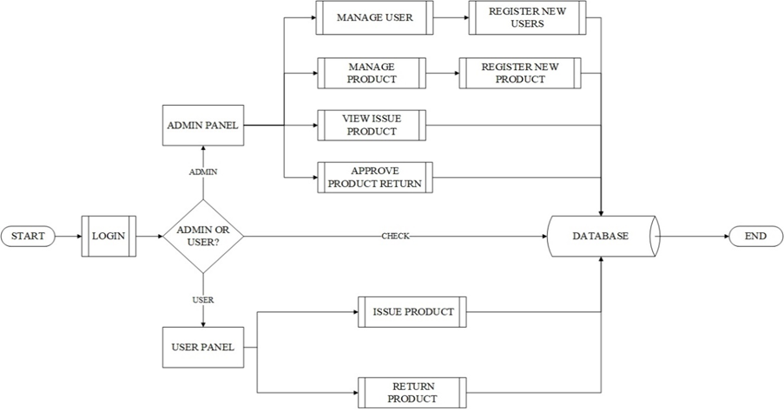
Architectural design

Slide 13
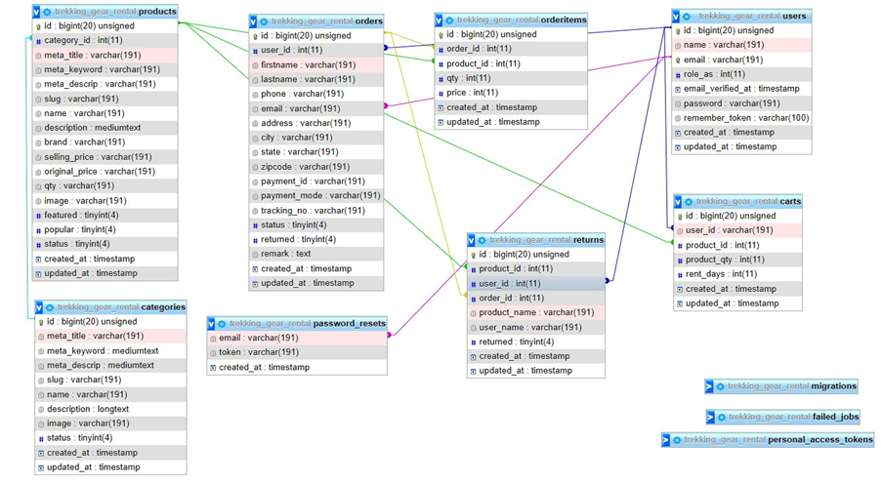
Database schema

Slide 14
Modules
Browser | Mozilla, Firefox
Operating System | Windows
IDE | Visual Studio Code
Database Server | MySQL
Web Server | Apache
Programming Language | PHP, JavaScript, HTML, CSS

Slide 15
conclusion
We can expect a fully functional website that can meet all the necessary needs of the consumer. Such as providing quality services as well as budget friendly products according to the needs and desire of the consumer with fast and easy service. Making the trekking and renting more convenient and budget-friendly as possible.

Slide 16
Future recommendations
In upcoming future, we will definitely refine our project with following enhancement.
Adding package system from client side so that users will be able to order fully customized packages.
Making the project more automatic and reliable as possible.
Developing user friendly mobile application version of this website.

Slide 17
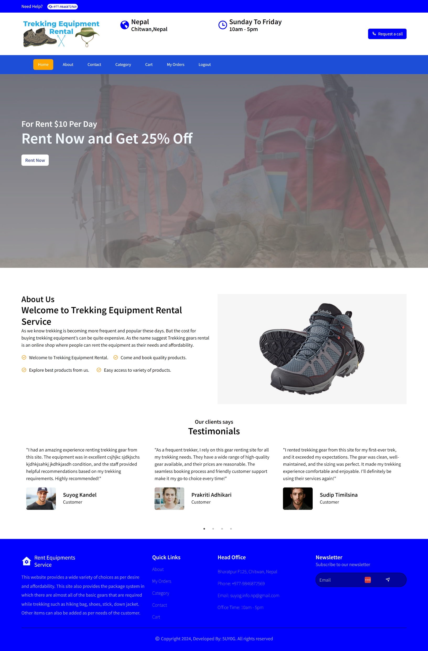

Slide 18
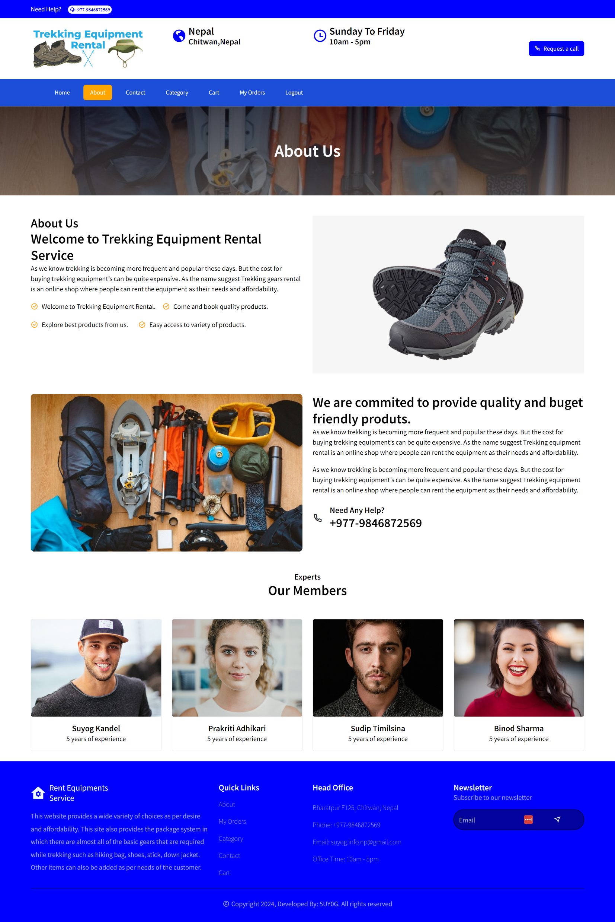

Slide 19
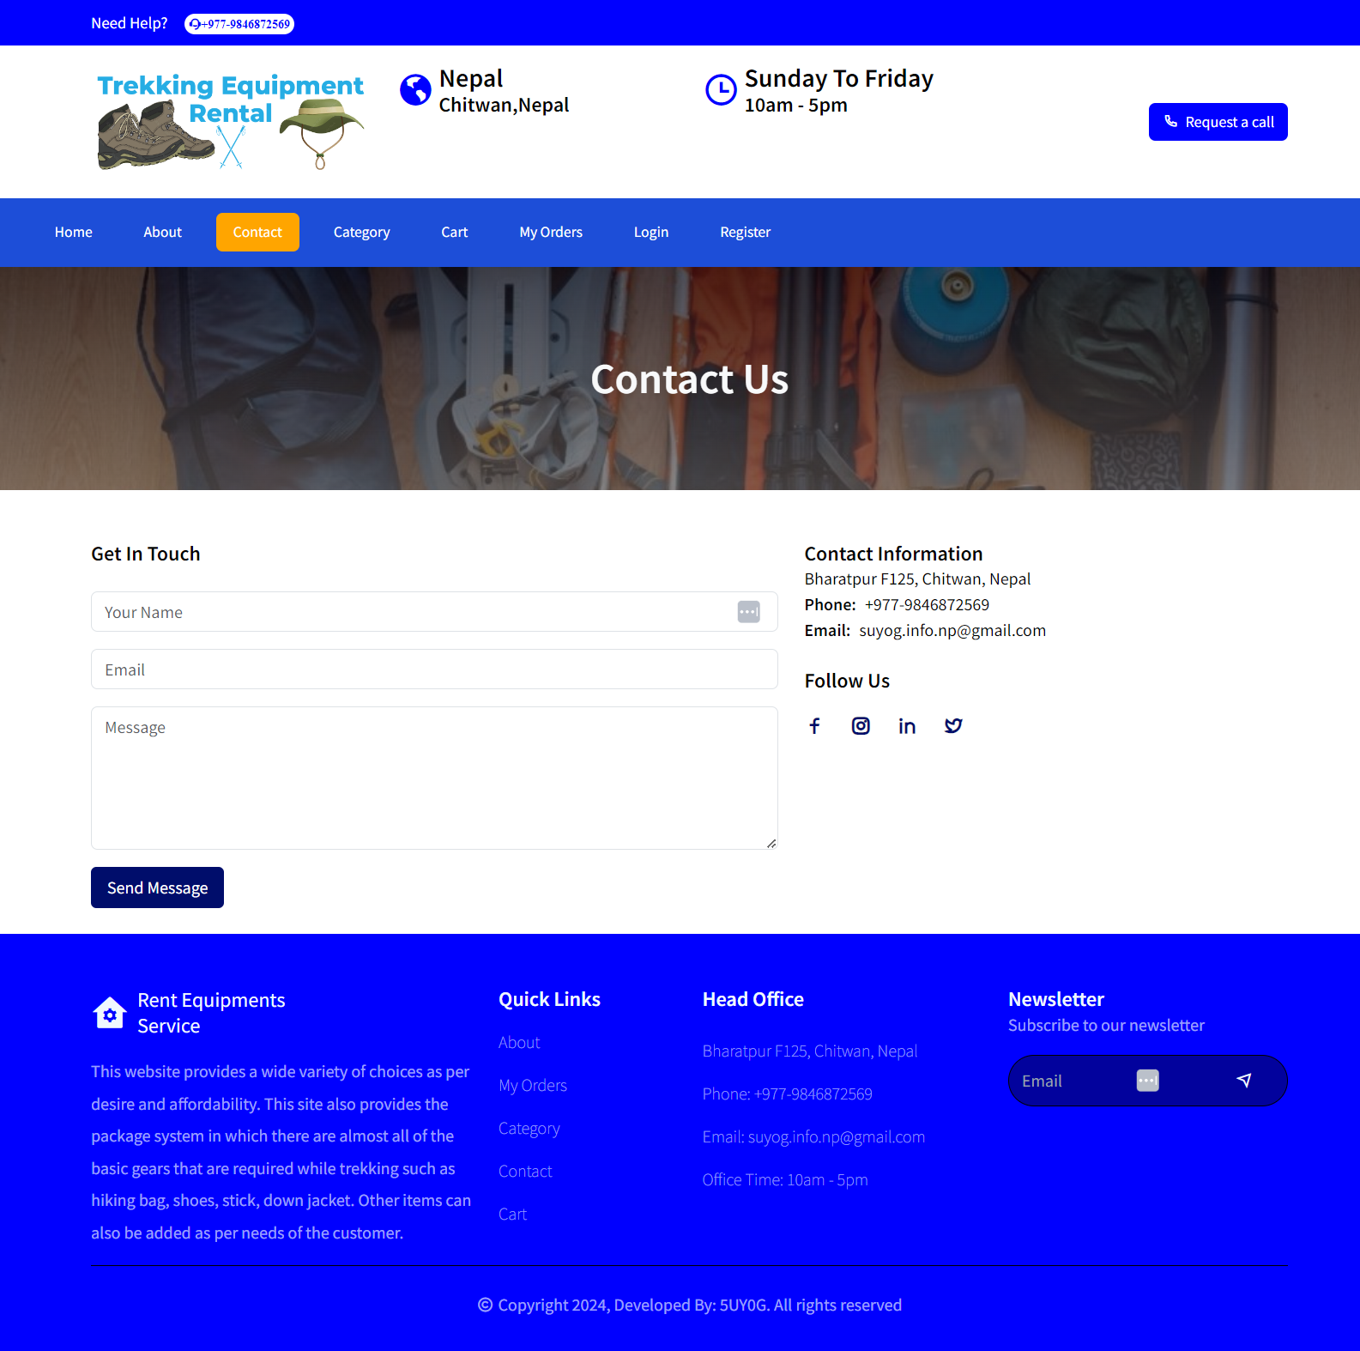

Slide 20
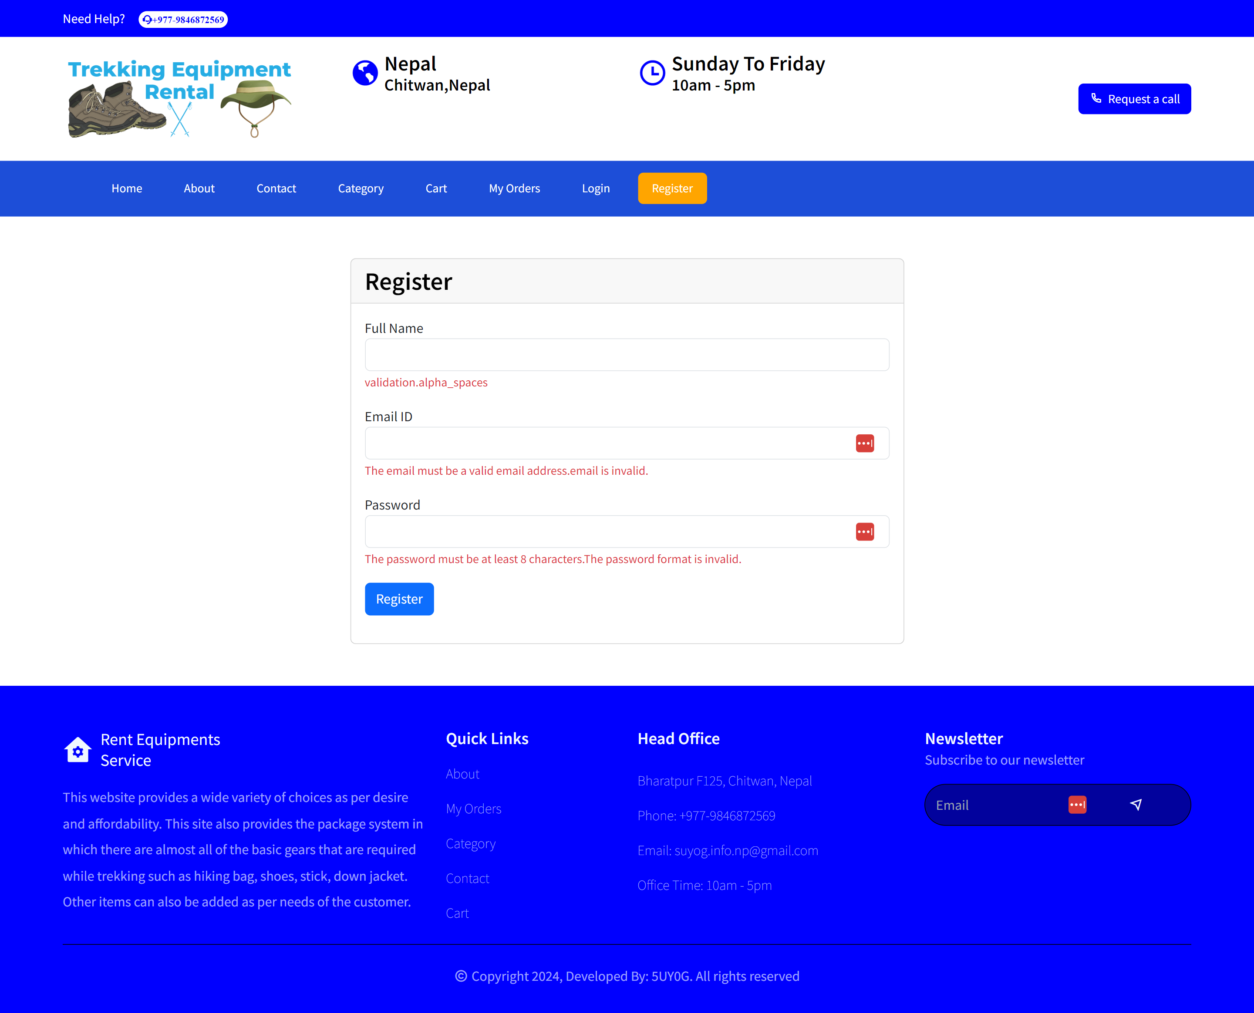

Slide 21
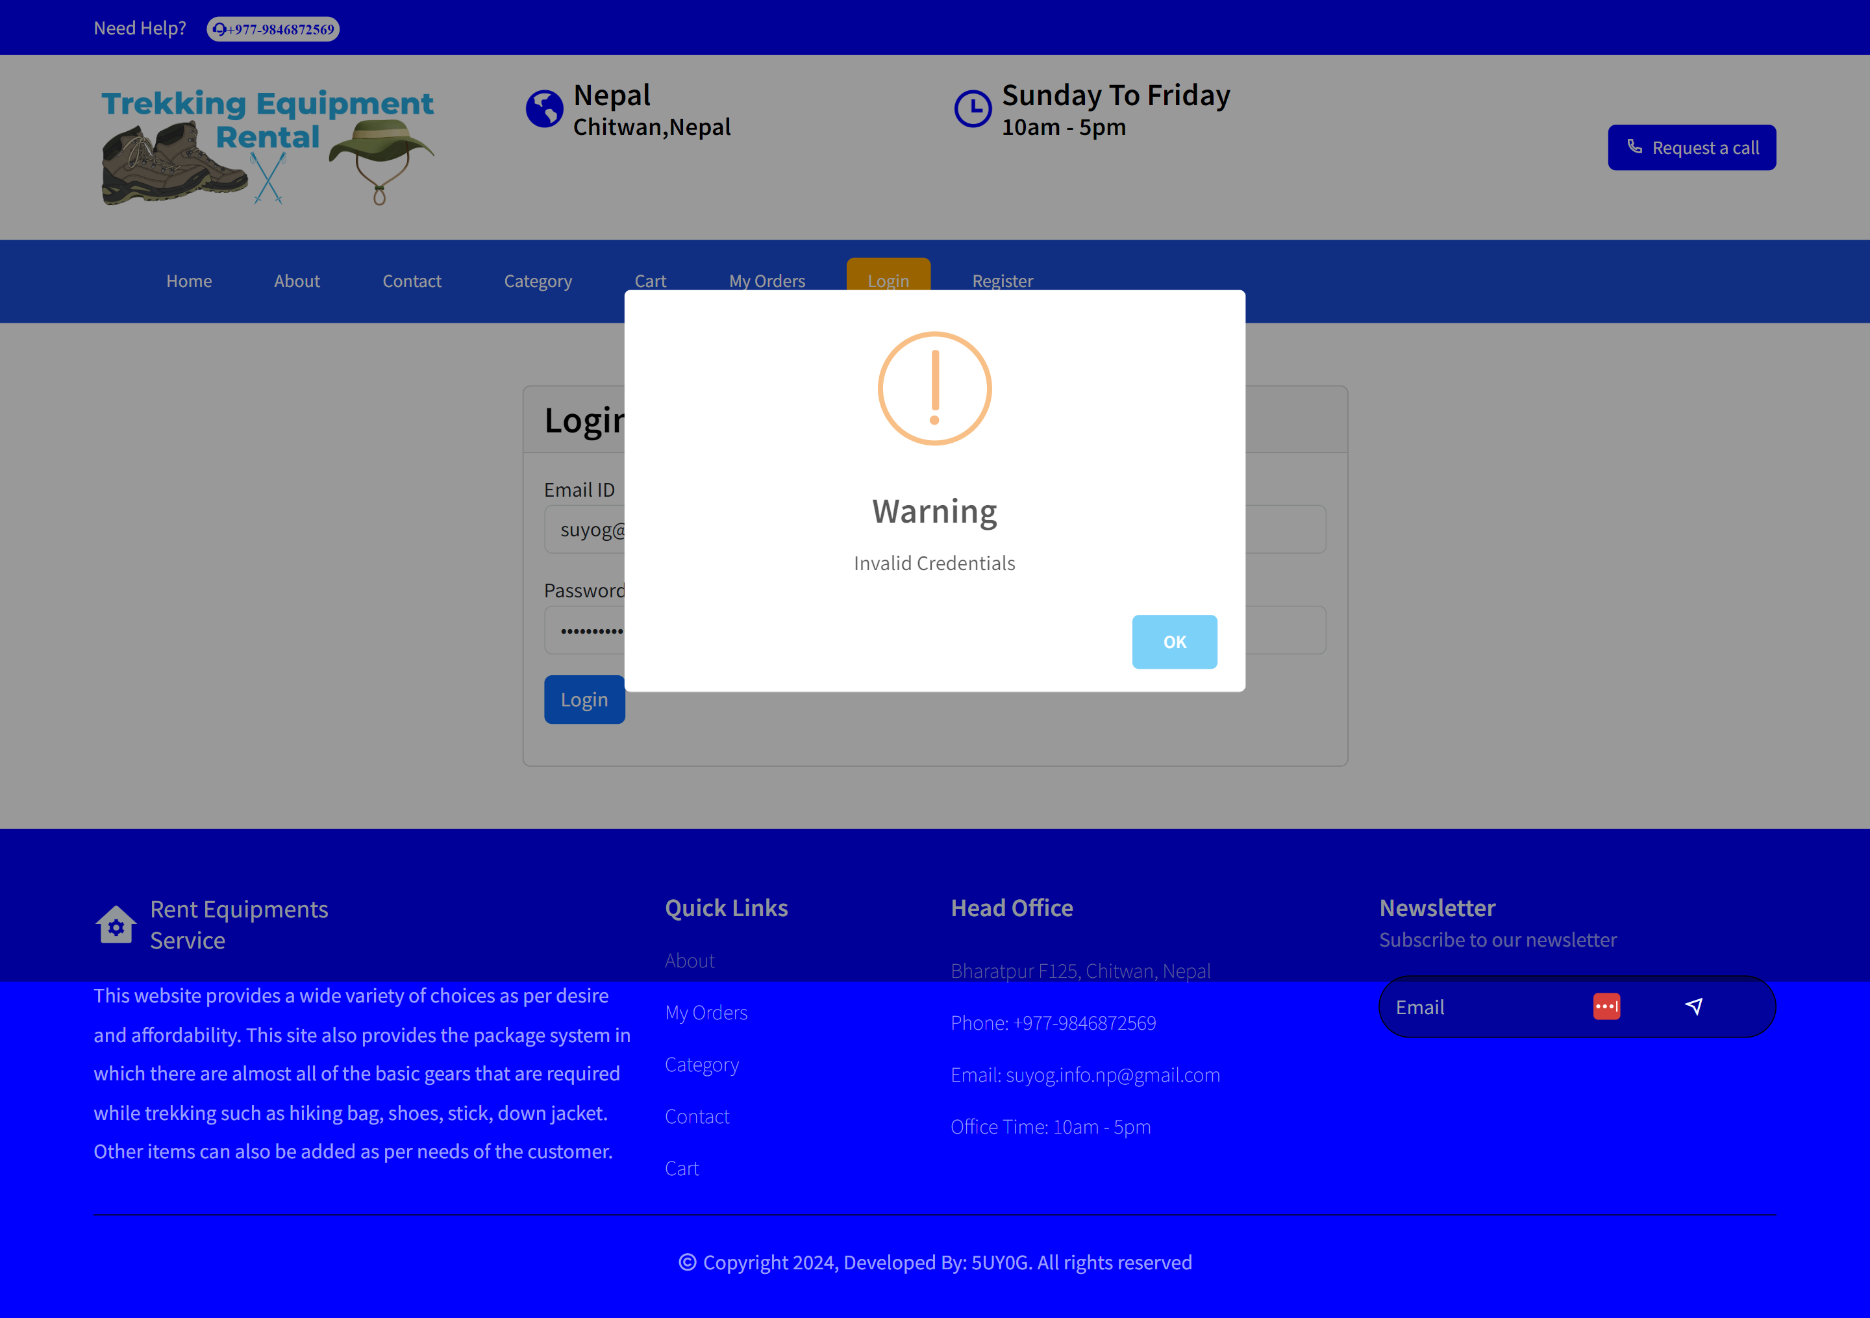

Slide 22
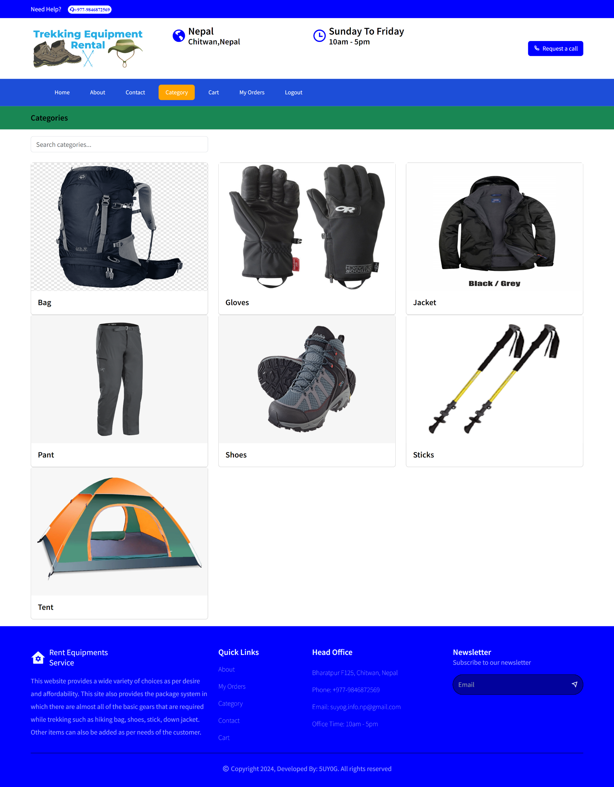

Slide 23
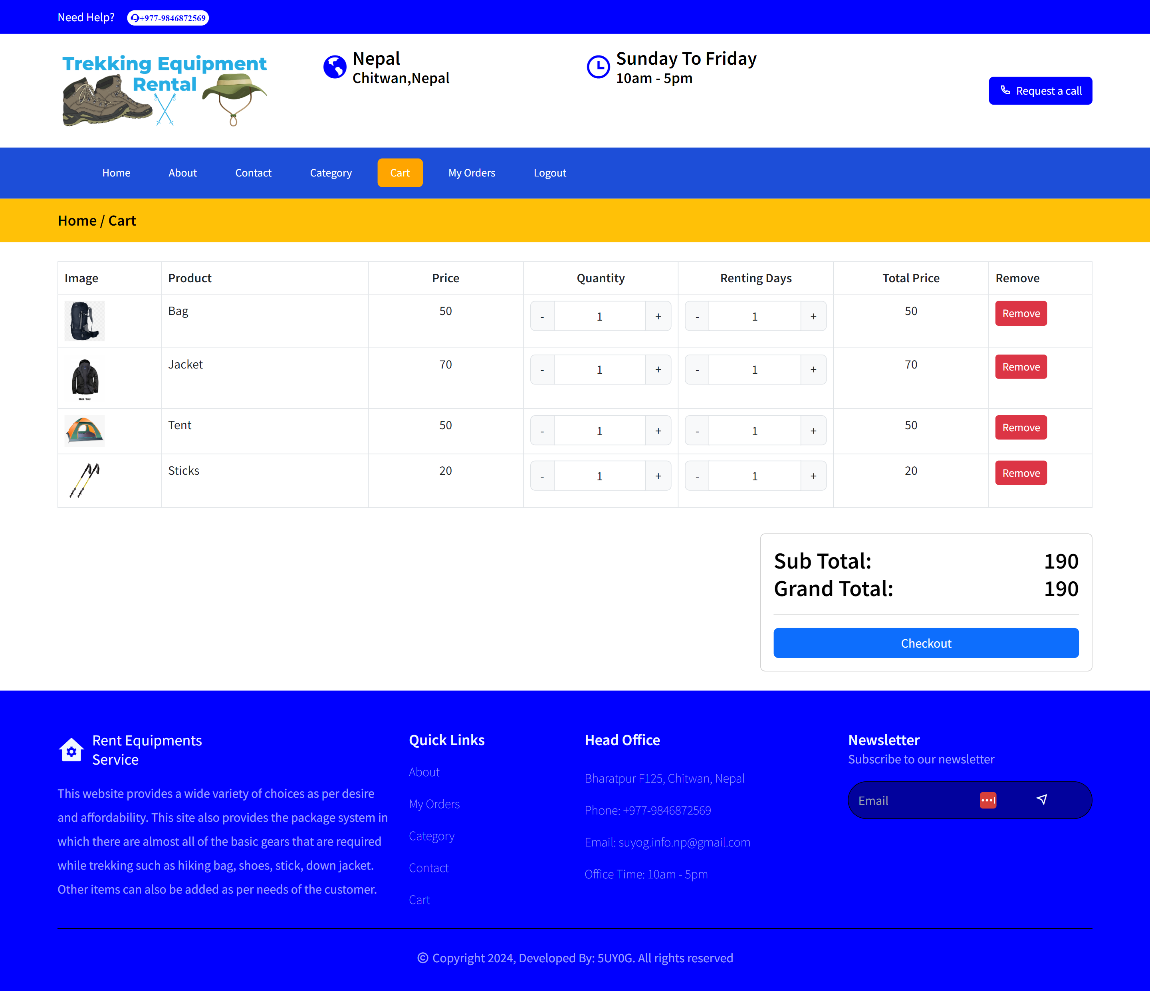

Slide 24
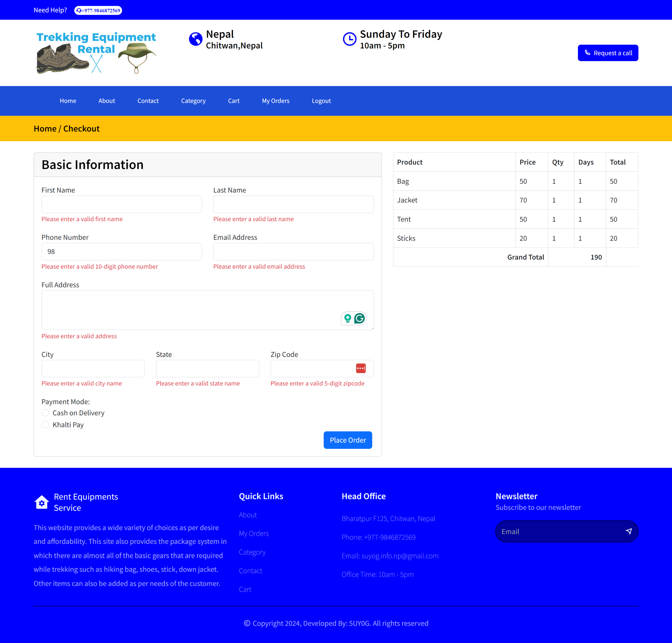

Slide 25
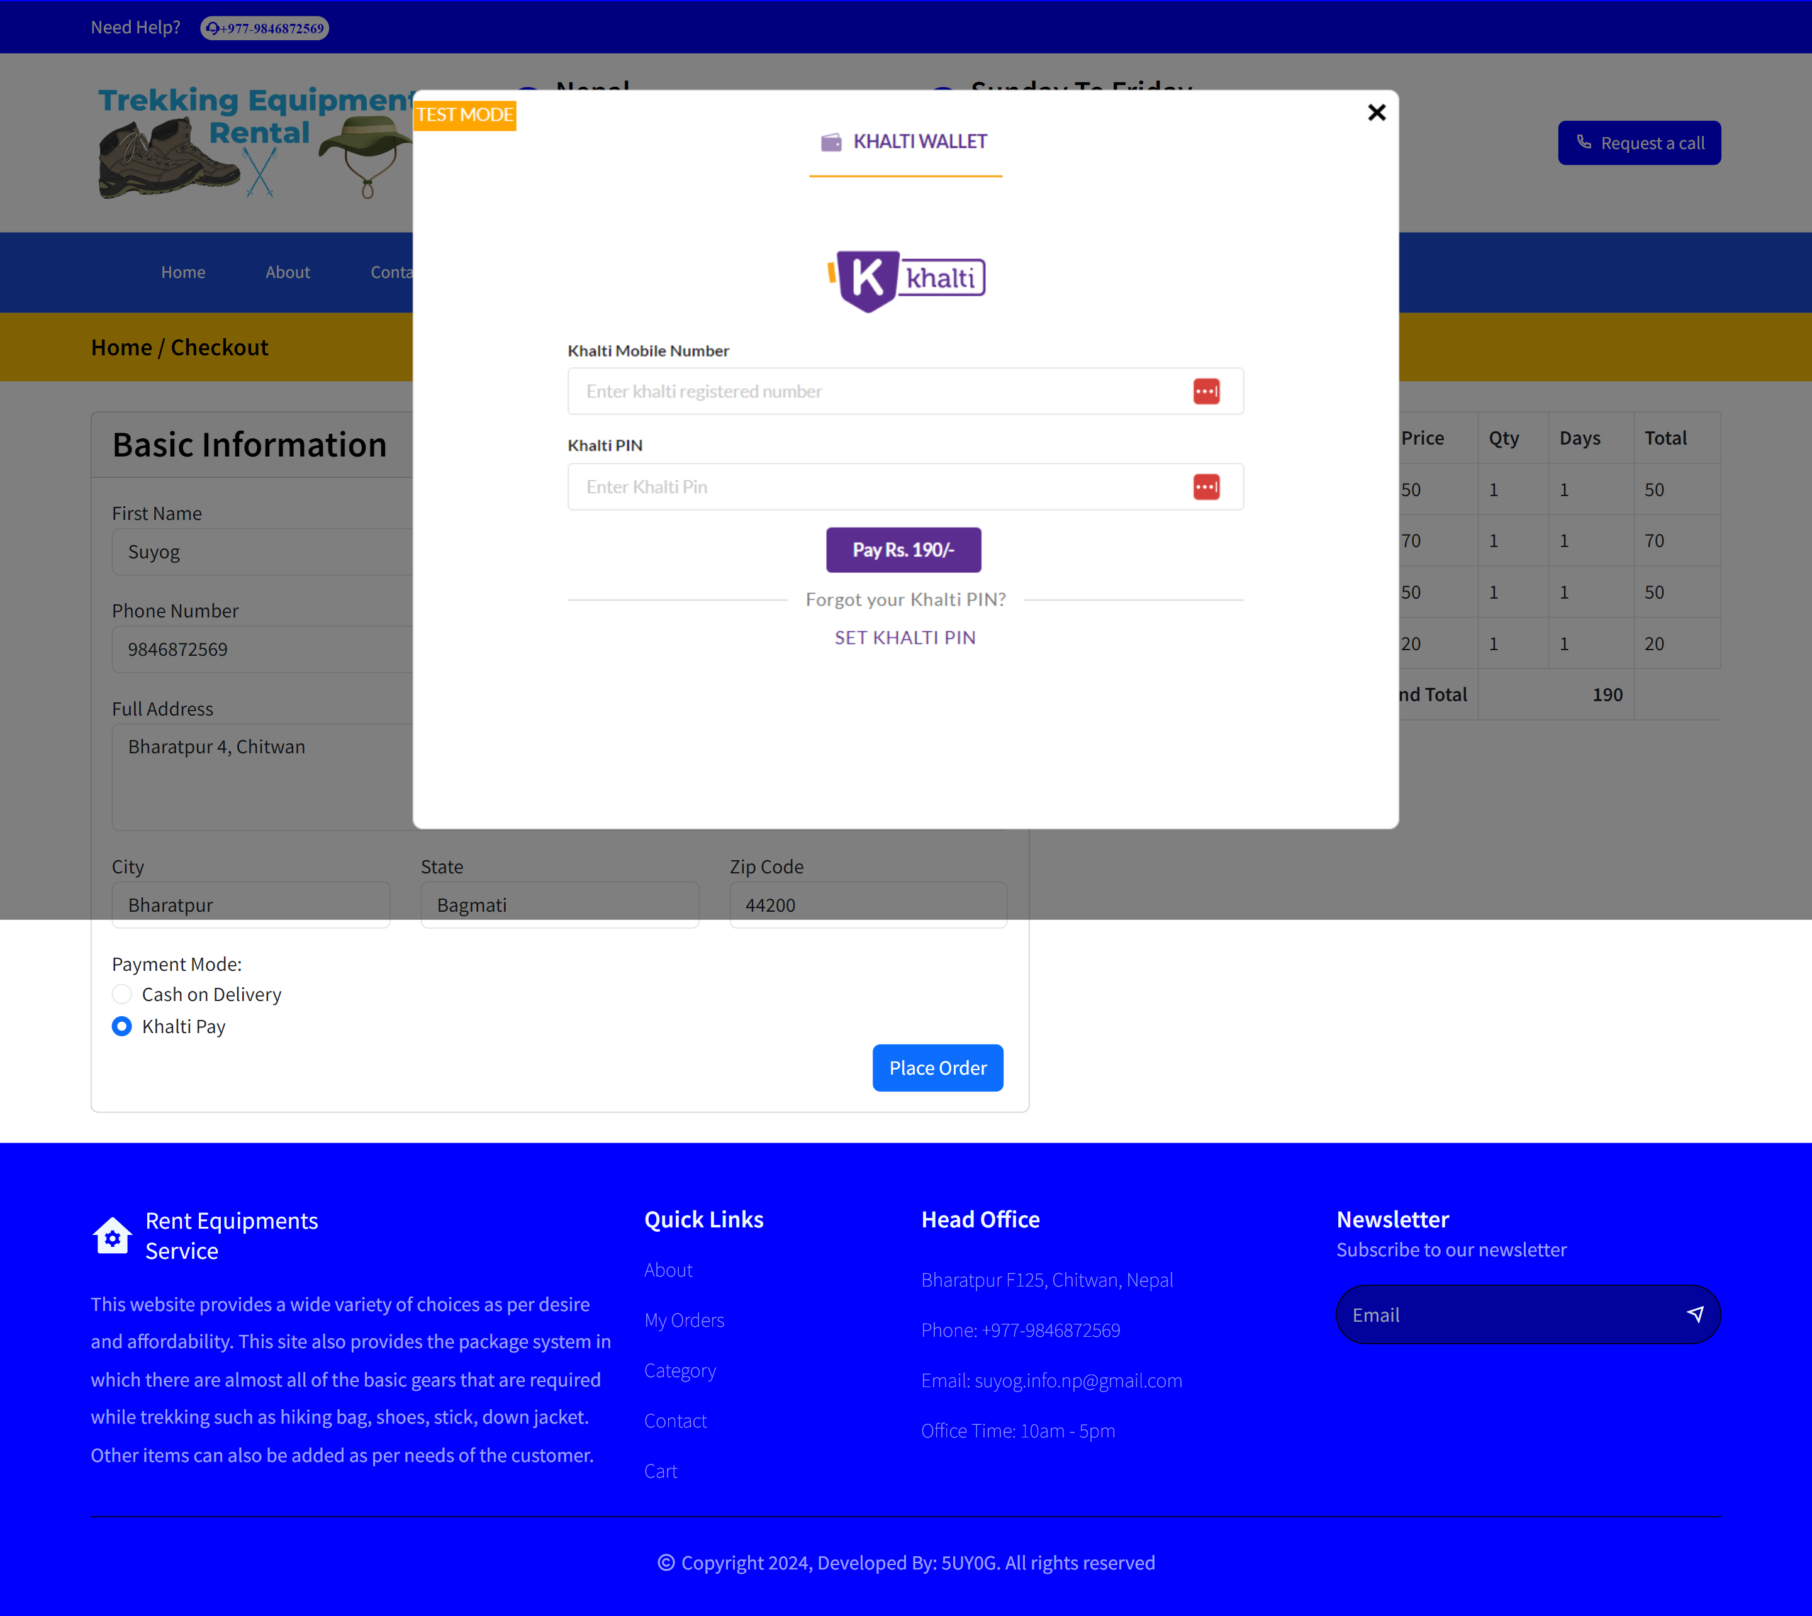

Slide 26
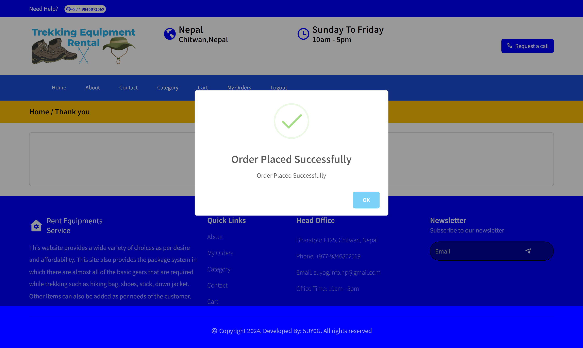

Slide 27
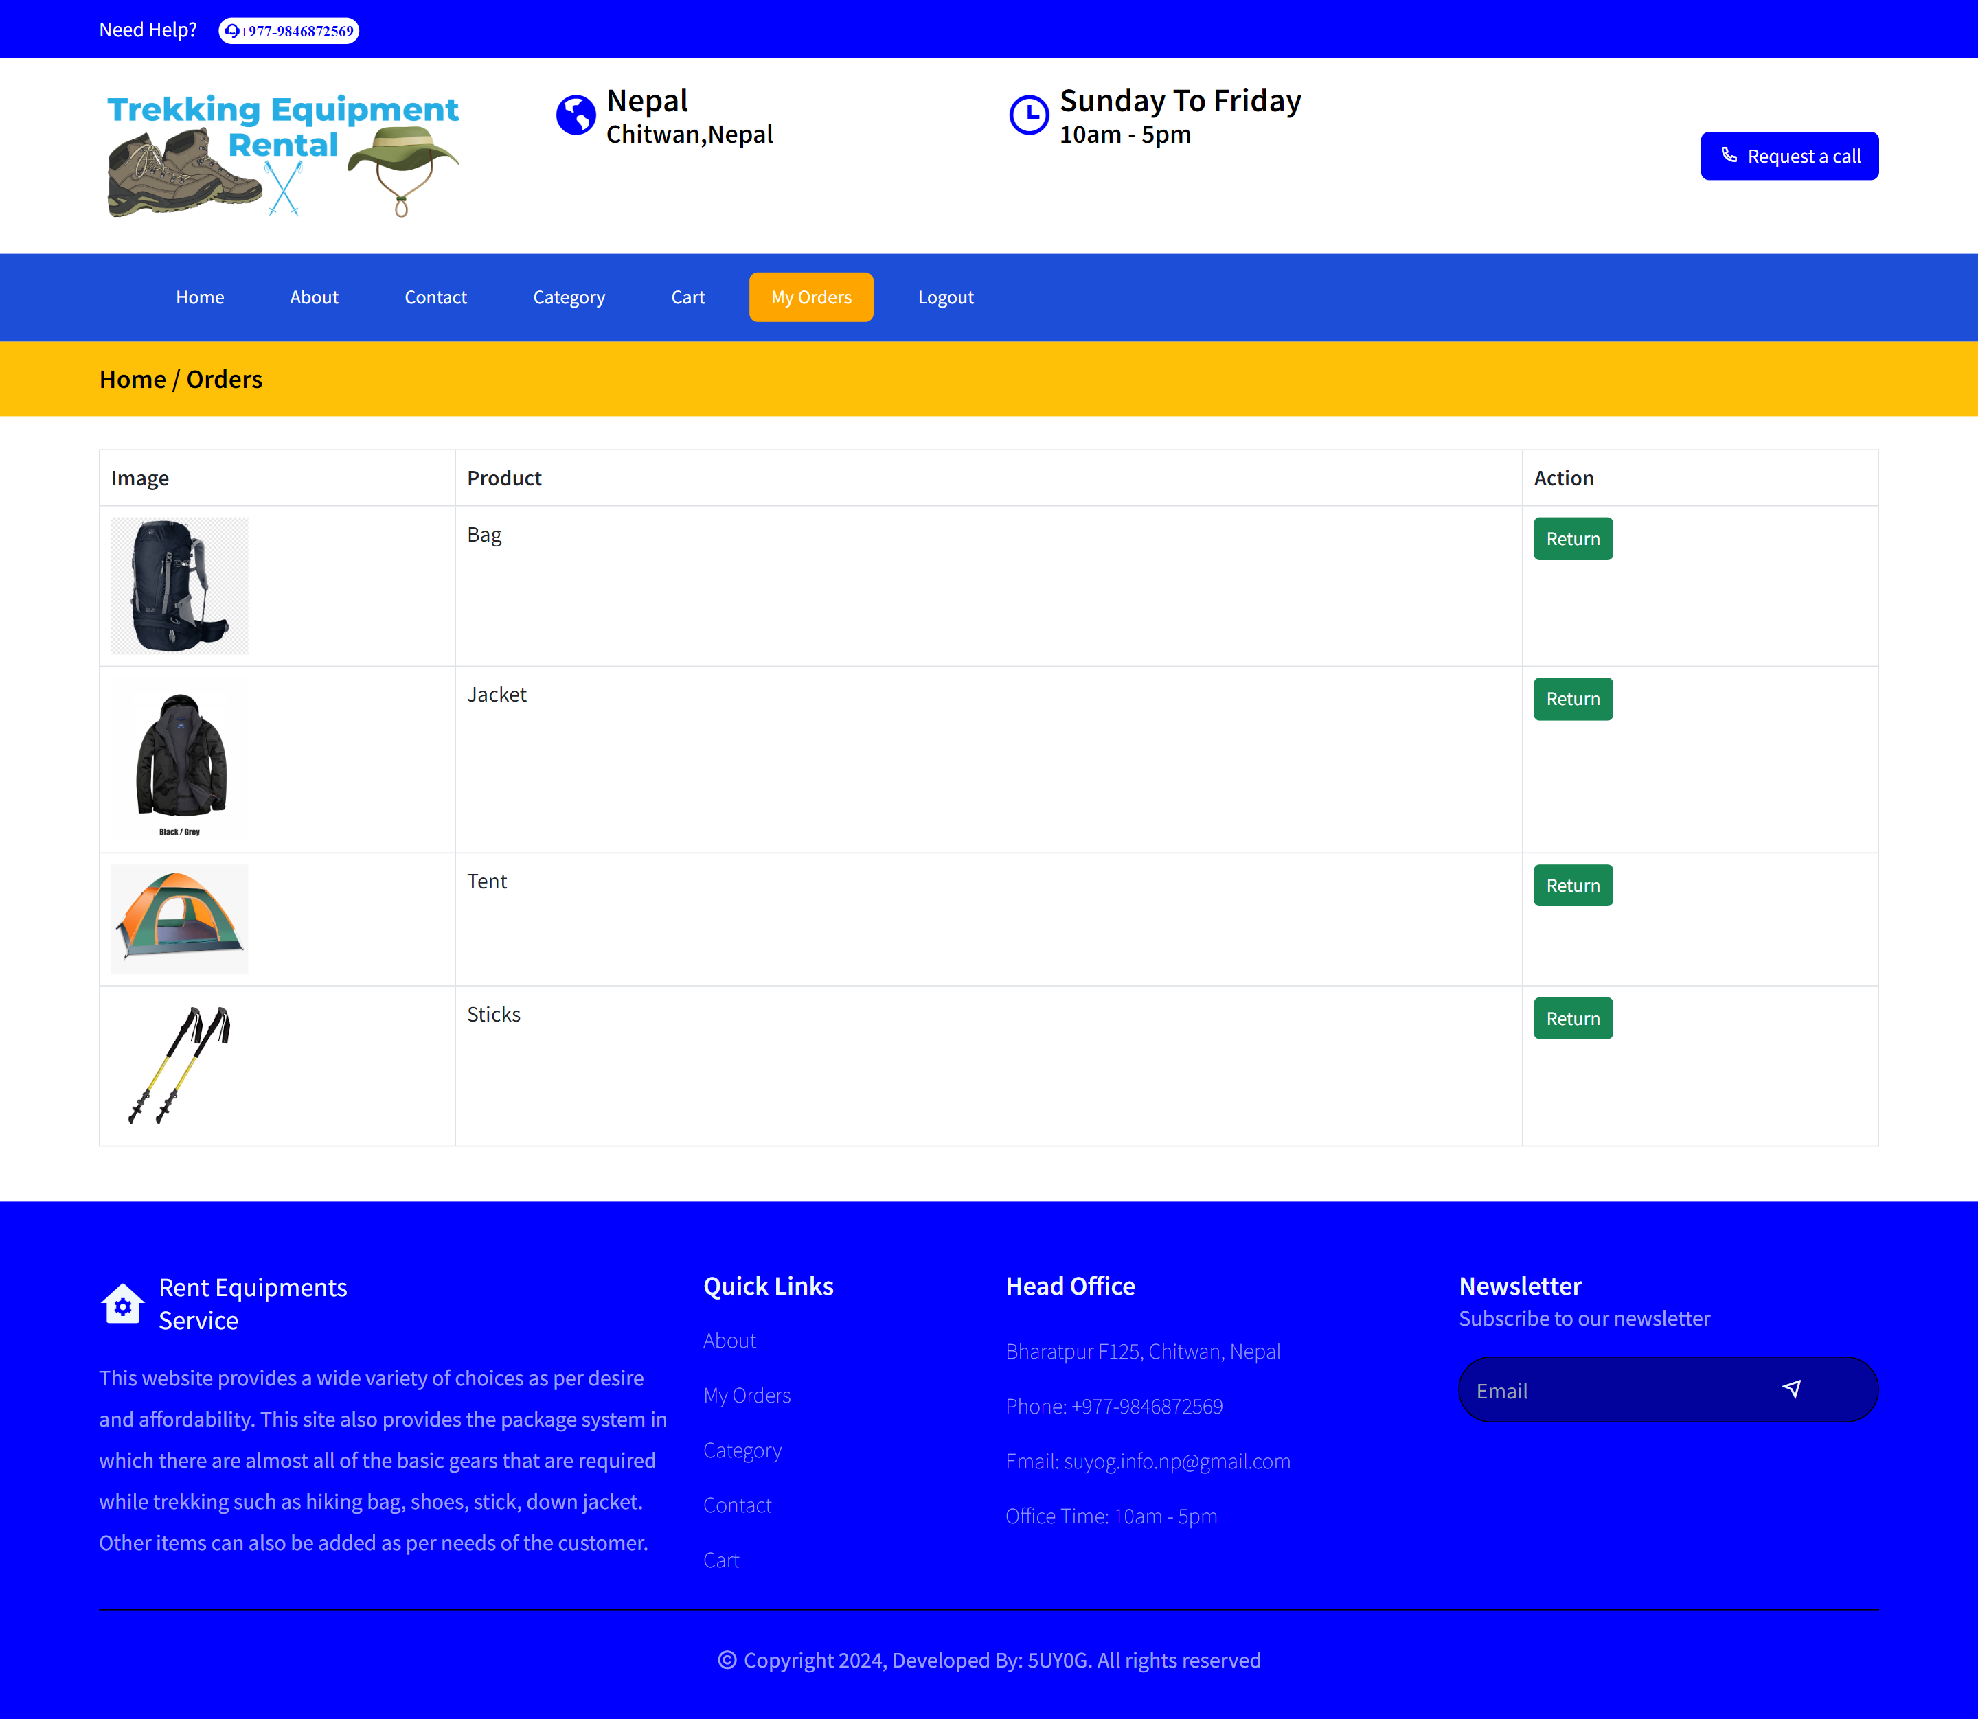

Slide 28
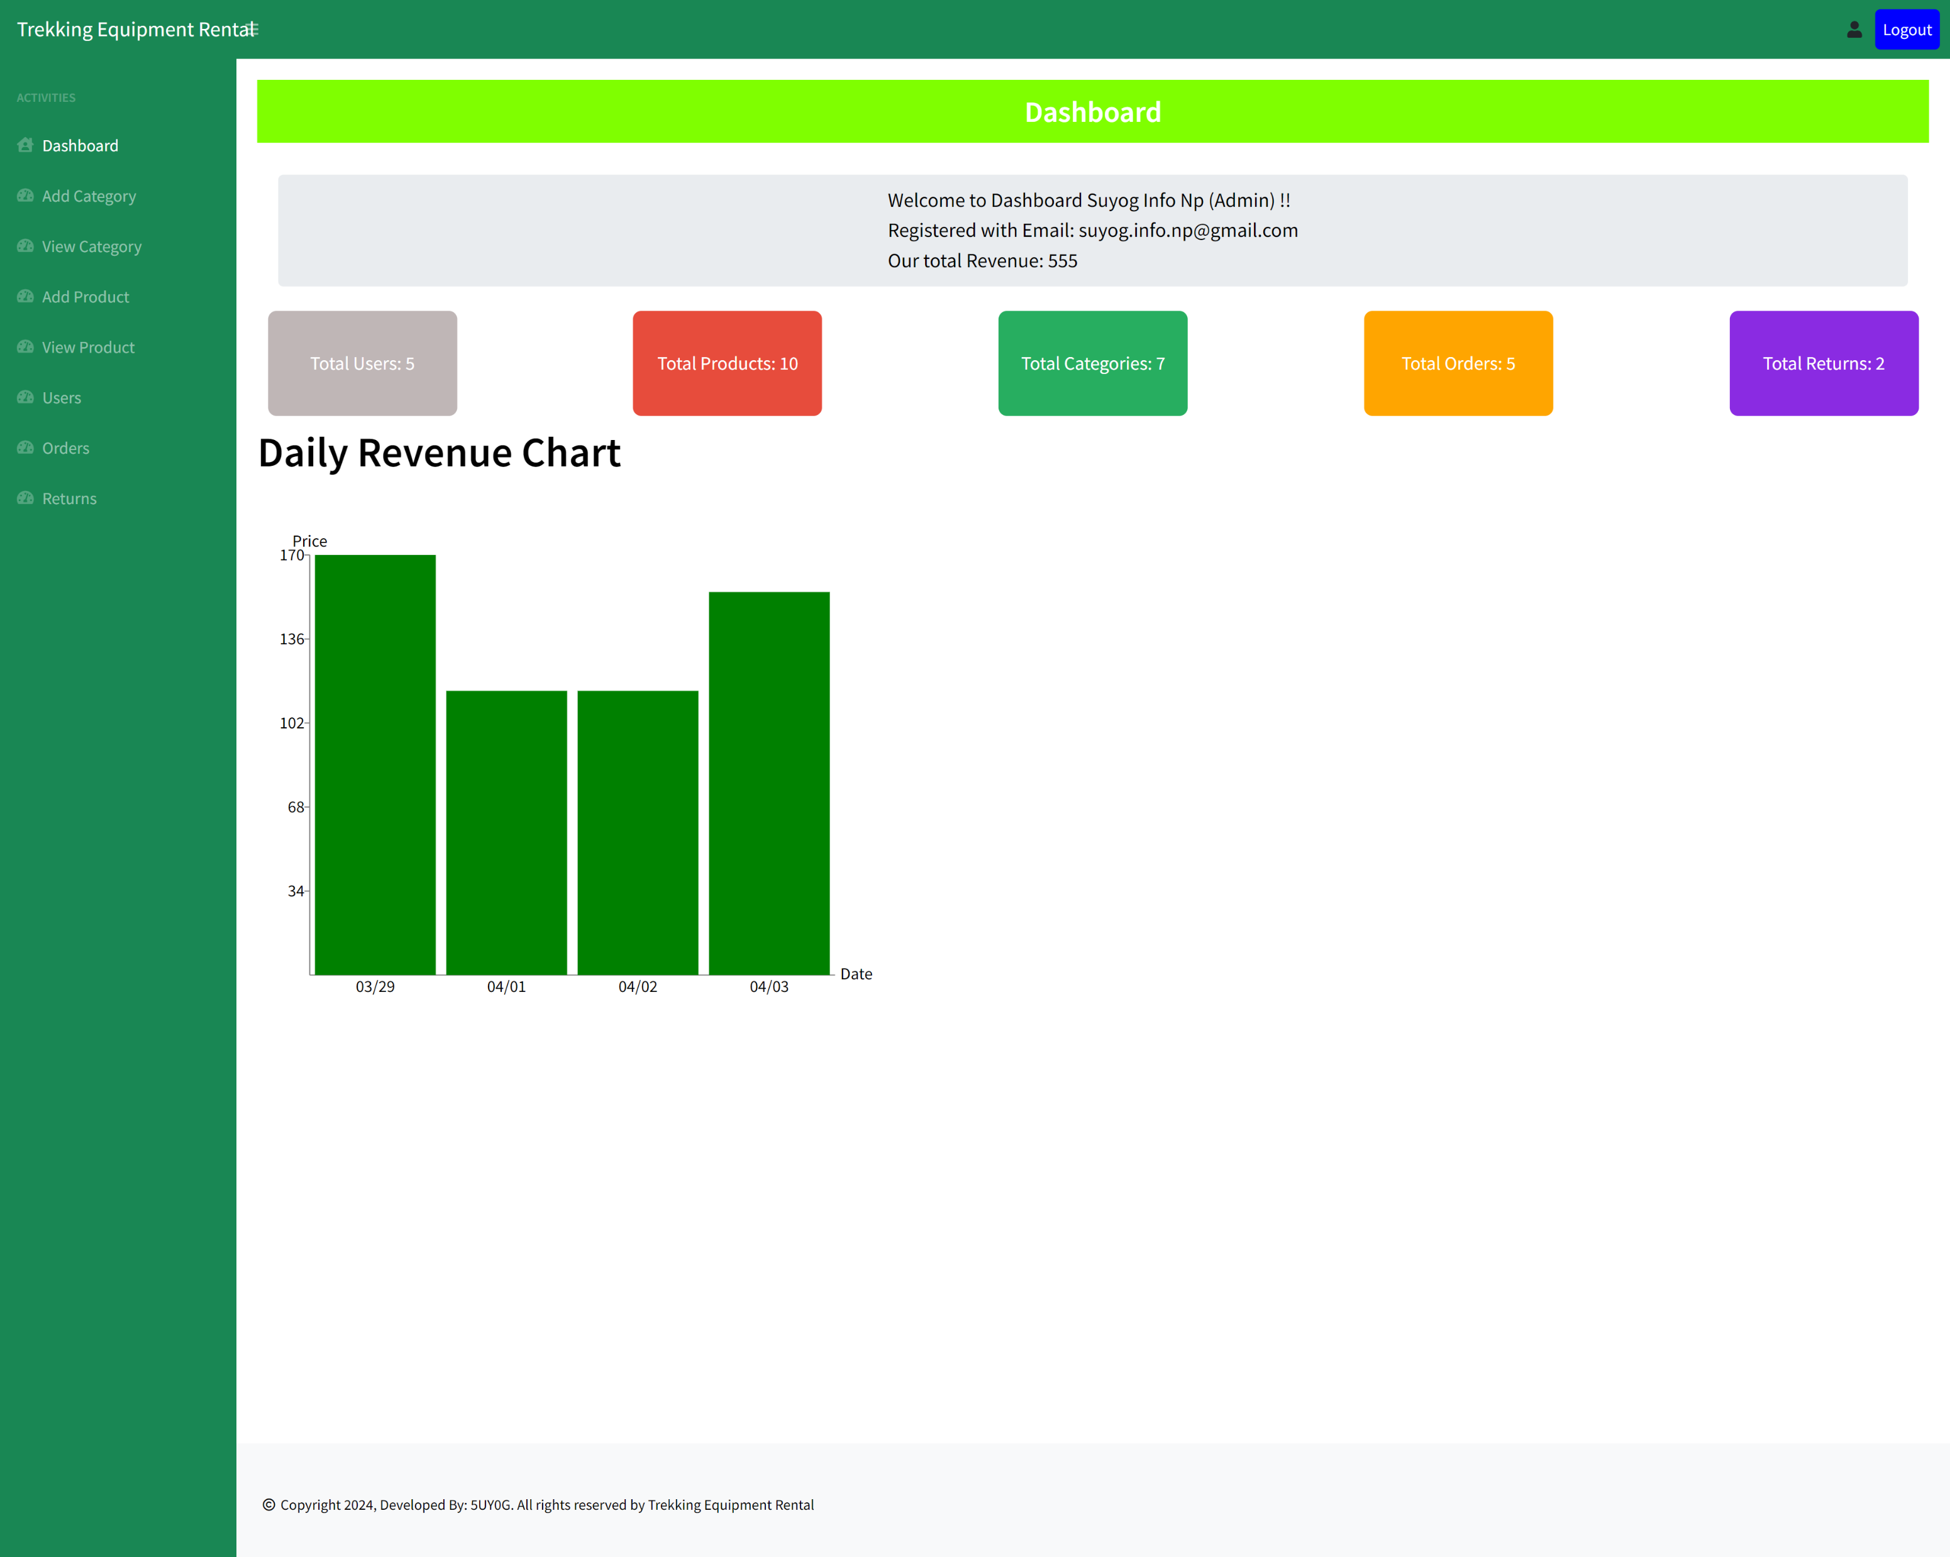

Slide 29
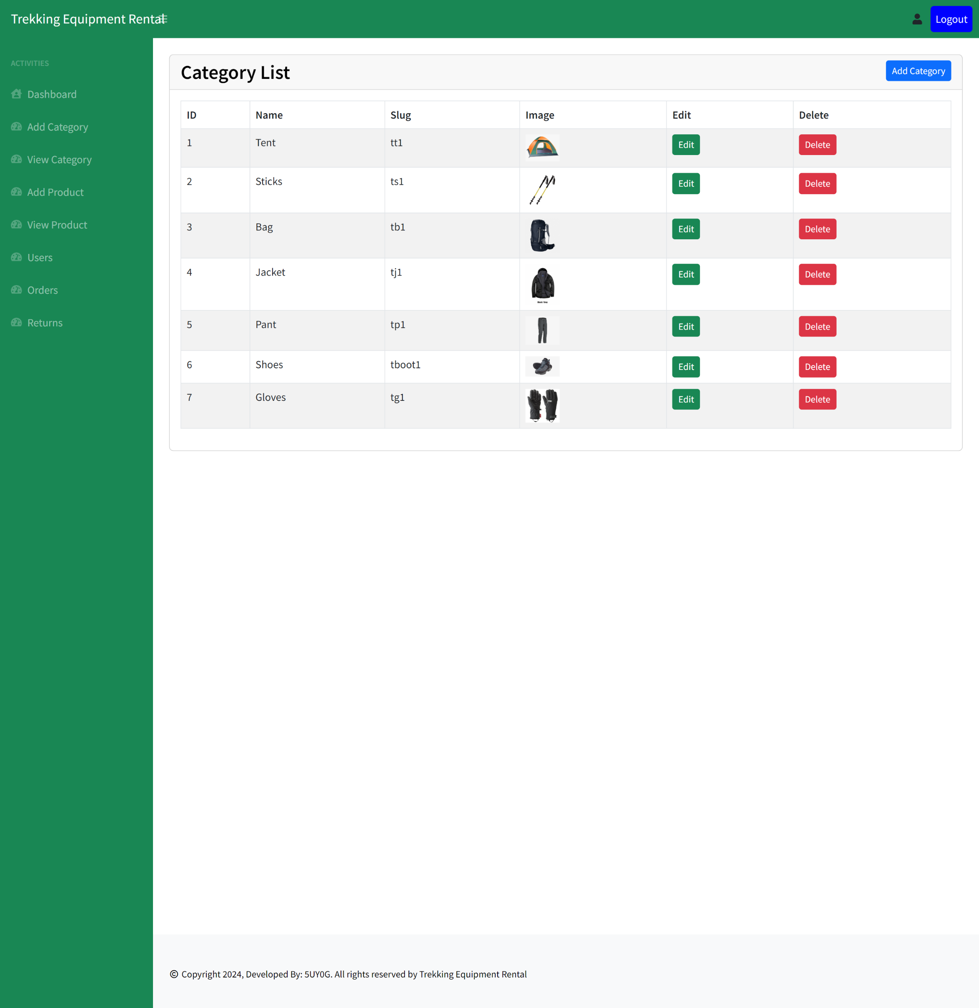

Slide 30
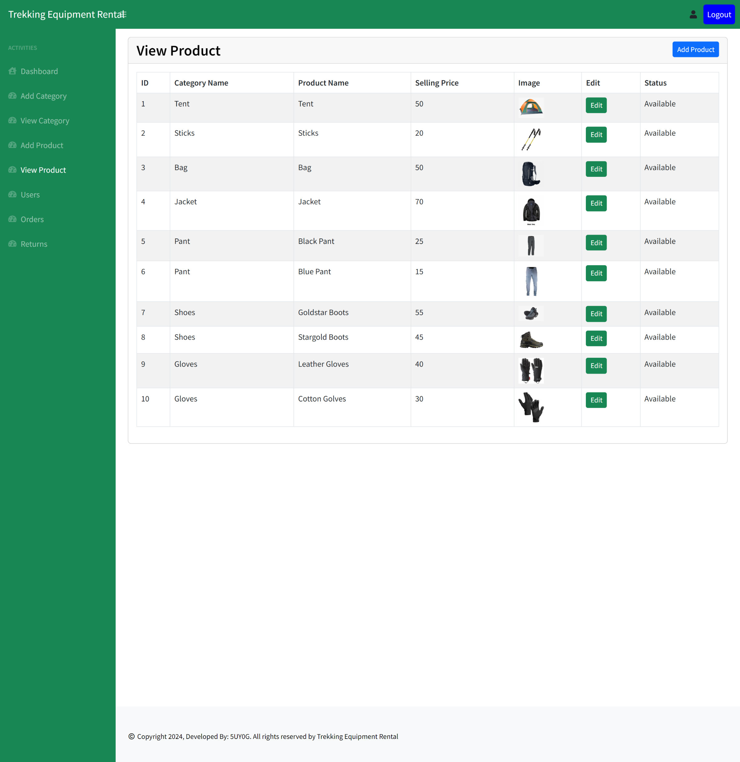

Slide 31
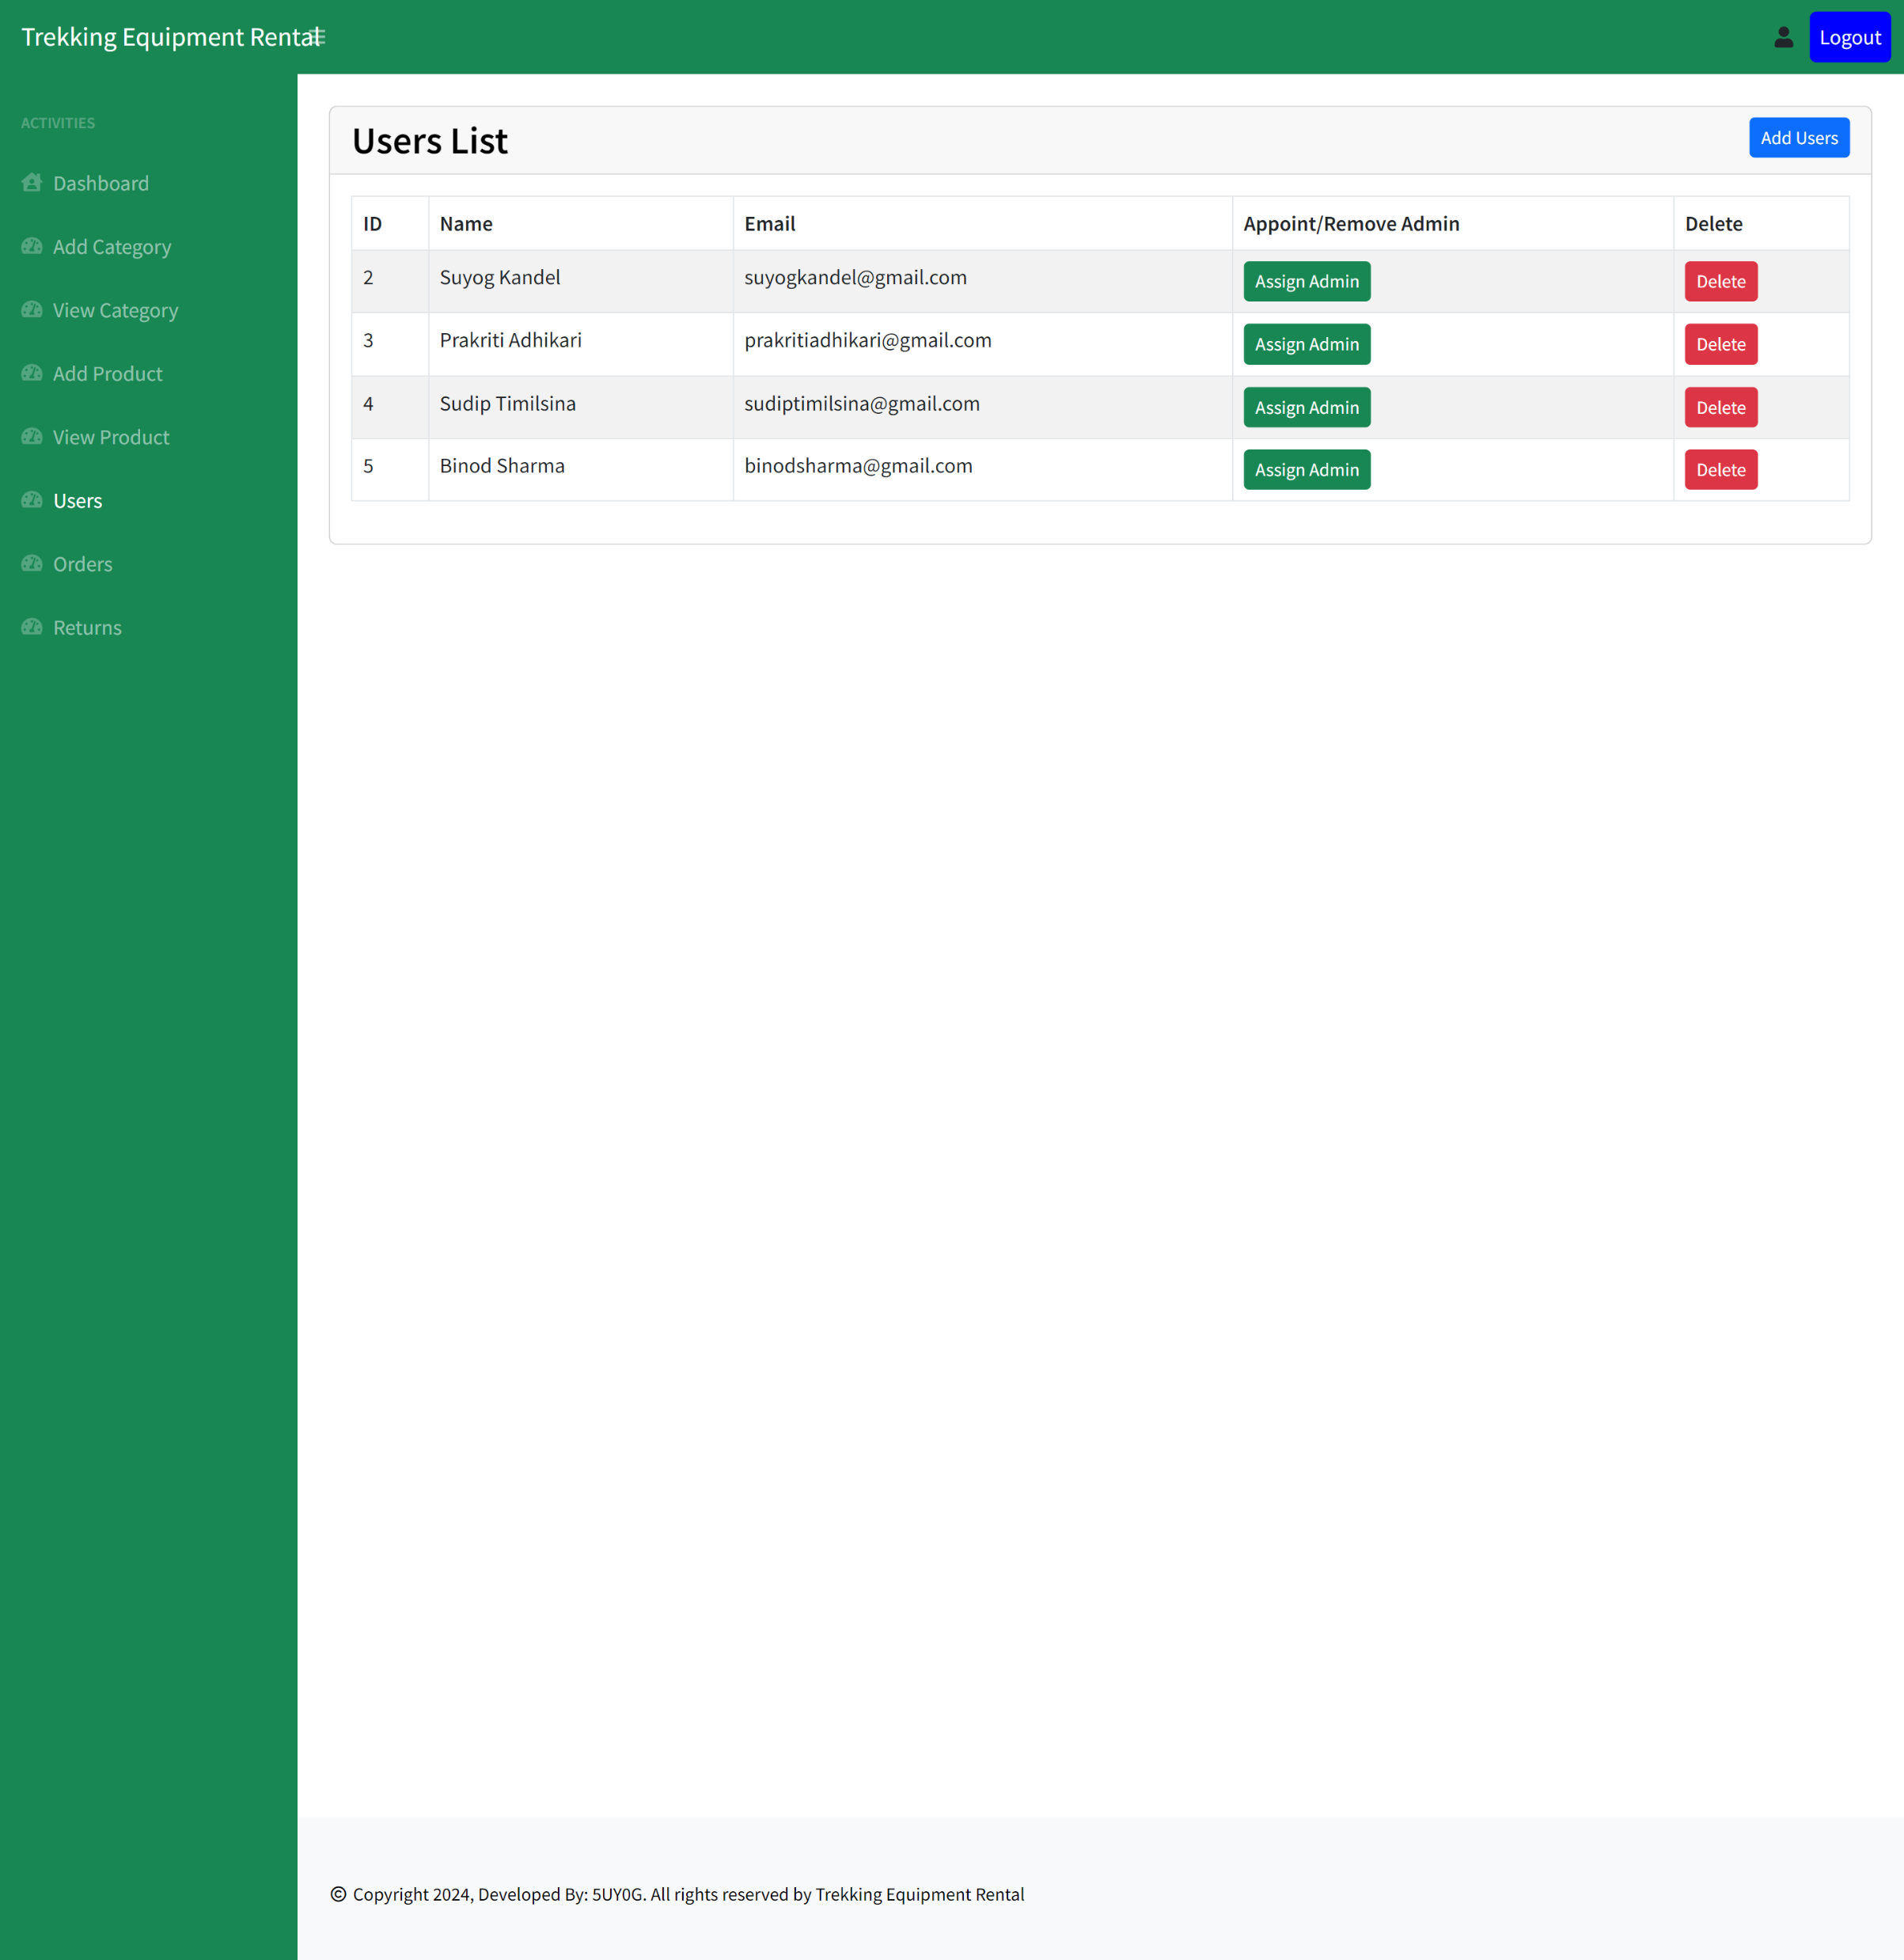

Slide 32
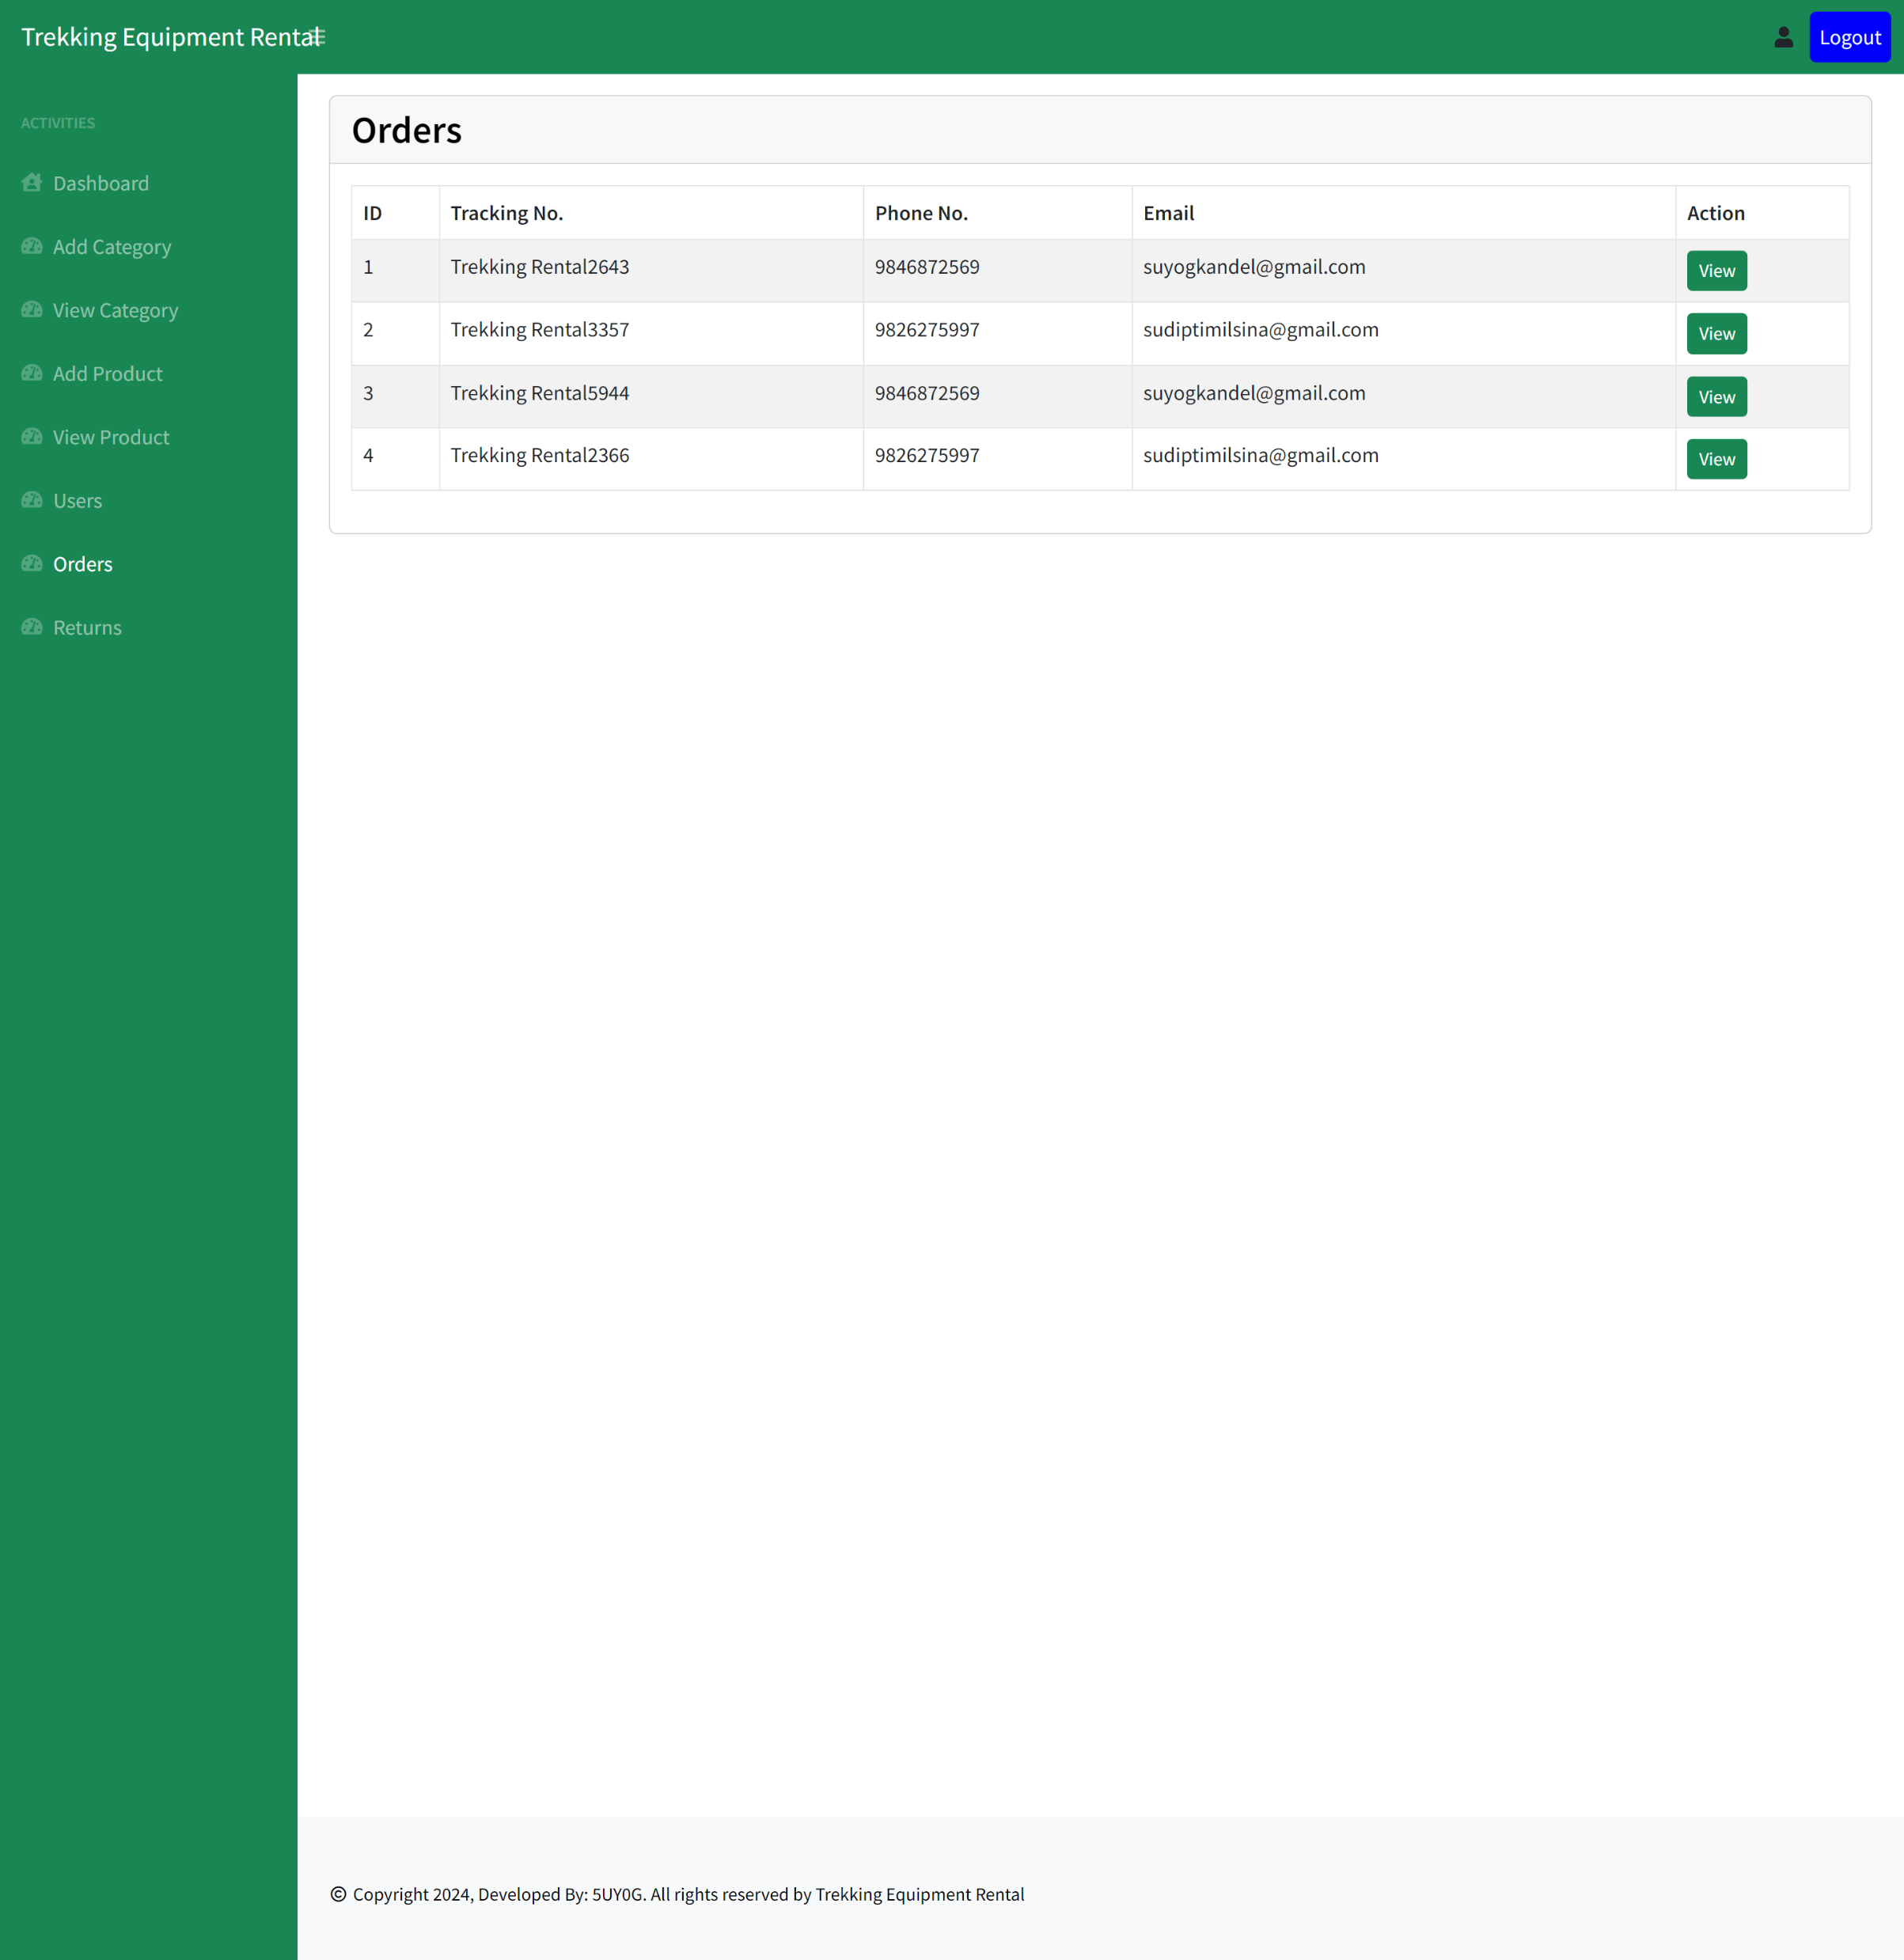

Slide 33
